Slide 1
Auto-Encoders for dimensionality reduction
Elad Hoffer

Slide 2
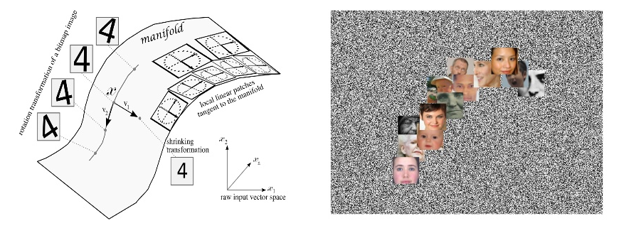
Dimensionality reduction
Dimensionality reduction from a learning perspective
The “Manifold Hypothesis”
Dimensionality of natural images

Slide 3
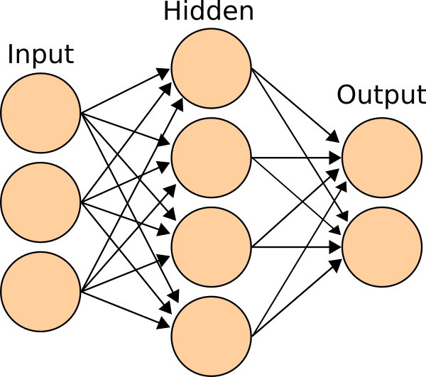
Neural network 101
NN structure
Objective & Loss function
SGD training
Backpropagation

Slide 4

Auto-Encoder
x₁
x₁
A neural network trained to reconstruct input from latent embedding
Can be decoupled as “Encoder” + “Decoder”
Reconstruction loss - MSE:
$$J\left(X;W_{1},W_{2}\right)=\sum_{i=1}^{N}{{\left\|x_{i}−W_{2}{(W}_{1}x_{i}+b_{1})−b_{2}\right\|}^{2}}$$
Usually $W_{2}=W_{1}^{′}$
$h_{i}$is a representation (preferably low-dimensional) of input $x_{i}$
x₂
x₂
h₁
x₃
x₃
h₂
x₄
x₄
h₃
x₅
x₅
+1
x₆
x₆
+1
Encoding
Decoding
Input

Slide 5

Auto-Encoder
Linear auto encoder with MSE loss is just another way to describe PCA (for centered inputs):
$$\sum_{i=1}^{N}{{\left\|x_{i}−W^{′}Wx_{i}\right\|}^{2}}=tr(W^{′}Σ_{X}W)$$
Nonlinearity and multiple layers will change this…
$$x_{i}=W^{′}σ\left(Wσ\left(x_{i}\right)+b_{1}\right)+b_{2}$$
e.g: the sigmoid non-linearity - $σ\left(x\right)= \frac{1}{1+e^{−x}}$

Slide 6
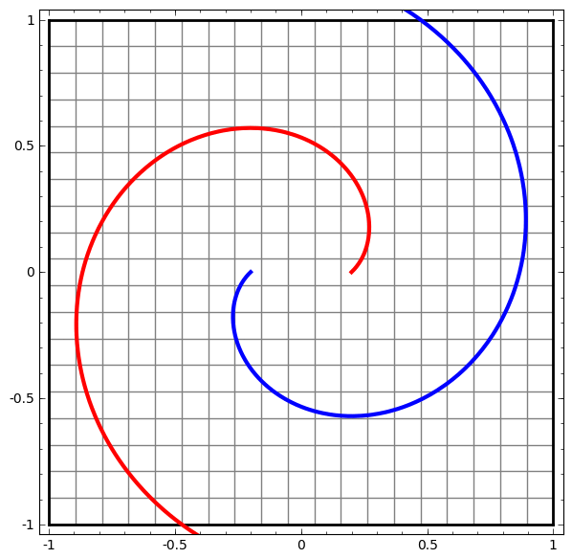
Non-linear embedding

Slide 7

Regularizing autoencoders
Avoiding the identity function
Under-complete vs over-complete representation
$L_{2}$ Regularization
Weight sharing, Convolutional layers
Sparse auto-encoder
Denoising auto-encoder
Contractive auto-encoder

Slide 8
Sparse coding
Sparse coding (Olshausen & Field,1996)
Input: Images x(1), x(2), …, x(m) (each in R^{nxn})
Learn: Dictionary of bases f₁, f₂, …, f_{k} (also R^{nxn}), so that each input x can be approximately decomposed as x= ∑ a_{j} * f_{j} , s.t. a_{j}’s are mostly zero (“sparse”).
Shalow NN, capture low-level concepts (e.g., edge “Gabor” filters) and simple invariances.

Slide 9
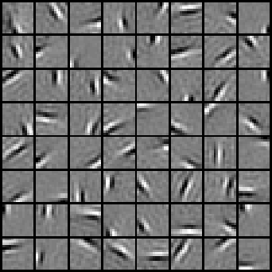
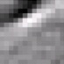
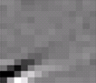

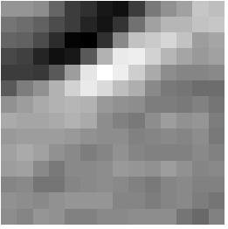
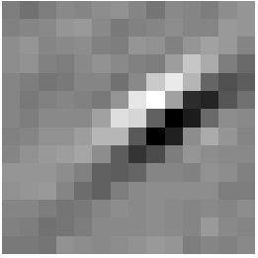
Sparse coding illustration
Learned bases (φ_{1 , …,} φ₆₄):
Natural Images
Test example
≈ 0.8 * + 0.3 * + 0.5 *
x ≈ 0.8 * φ₃₆ + 0.3 * φ₄₂ + 0.5 * φ₆₃
[0, 0, …, 0, 0.8, 0, …, 0, 0.3, 0, …, 0, 0.5, …]
= [a₁, …, a₆₄] (feature representation)

Slide 10
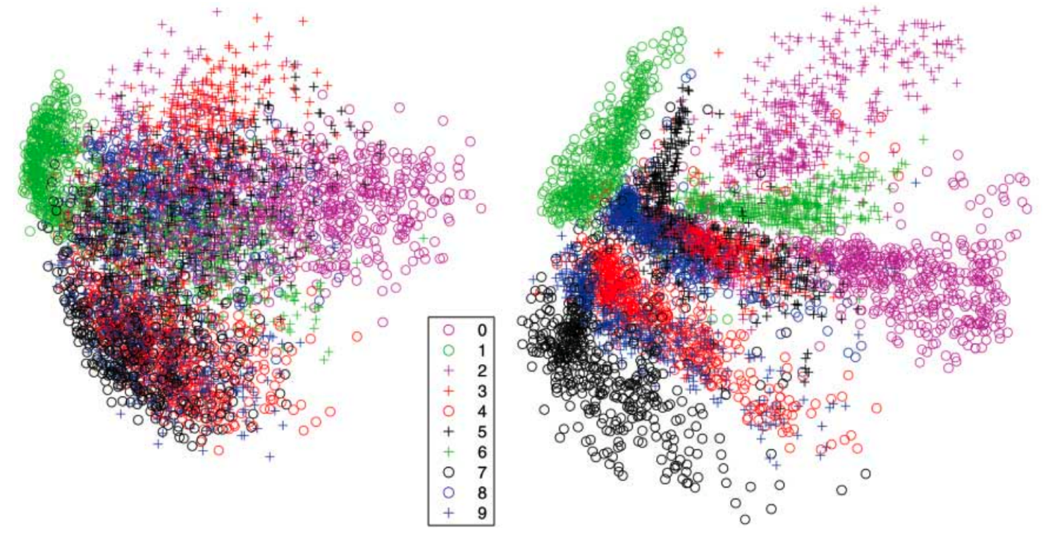
Examples – MNIST digits

Slide 11
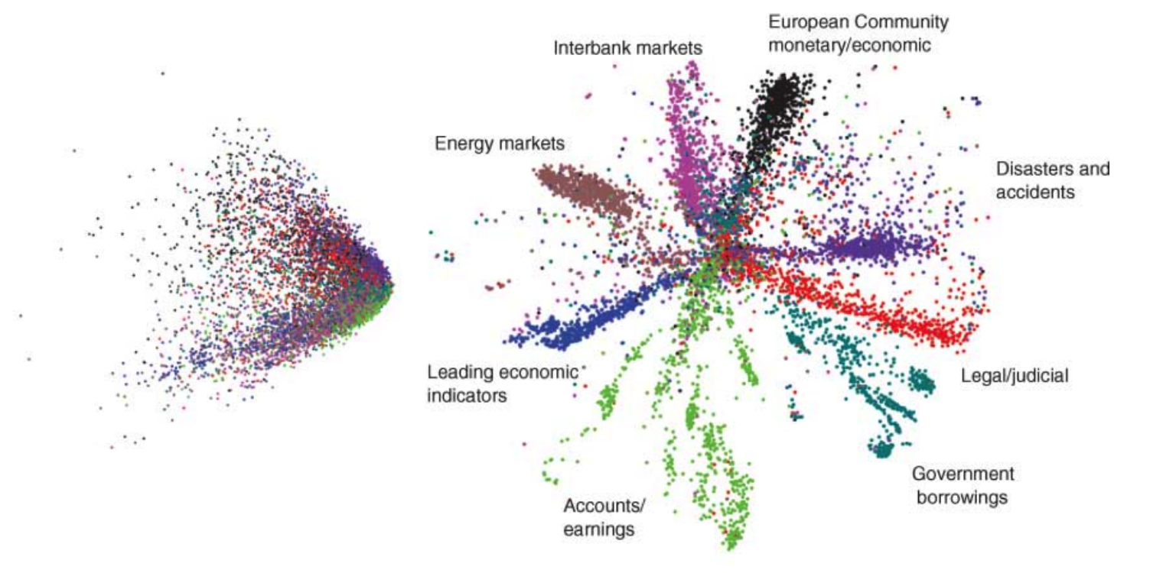
Examples – Text dataset

Slide 12
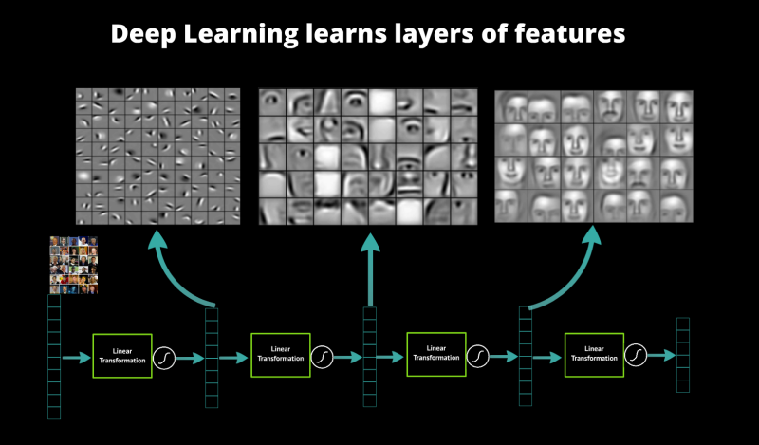
Deep learning

Slide 13
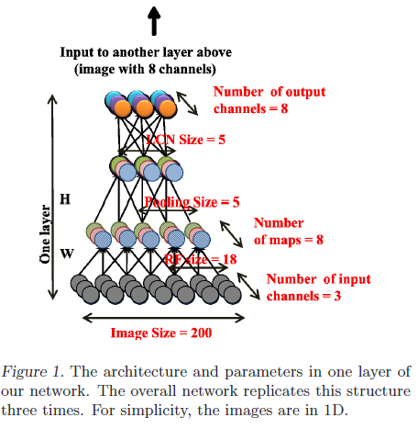
Deep Auto-encoder
Le et al. (Google/Stanford) “Building High-level Features Using Large Scale Unsupervised Learning”
Dataset: 10 million 200x200 unlabeled images from YouTube/Web
Trained on 2000 machines (16000 cores) for 1 week using Google infrastructure
1.15 billion parameters
100x larger than previously reported

Slide 14

Deep autoencoder
Architecture:
Trained using unsupervised data, layer by layer

Slide 15
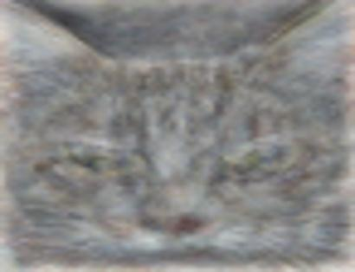
The “cat neuron”
Optimal stimulus
by numerical optimization
Le, et al., Building high-level features using large-scale unsupervised learning. ICML 2012
Notes:
Funny new york times article

Slide 16
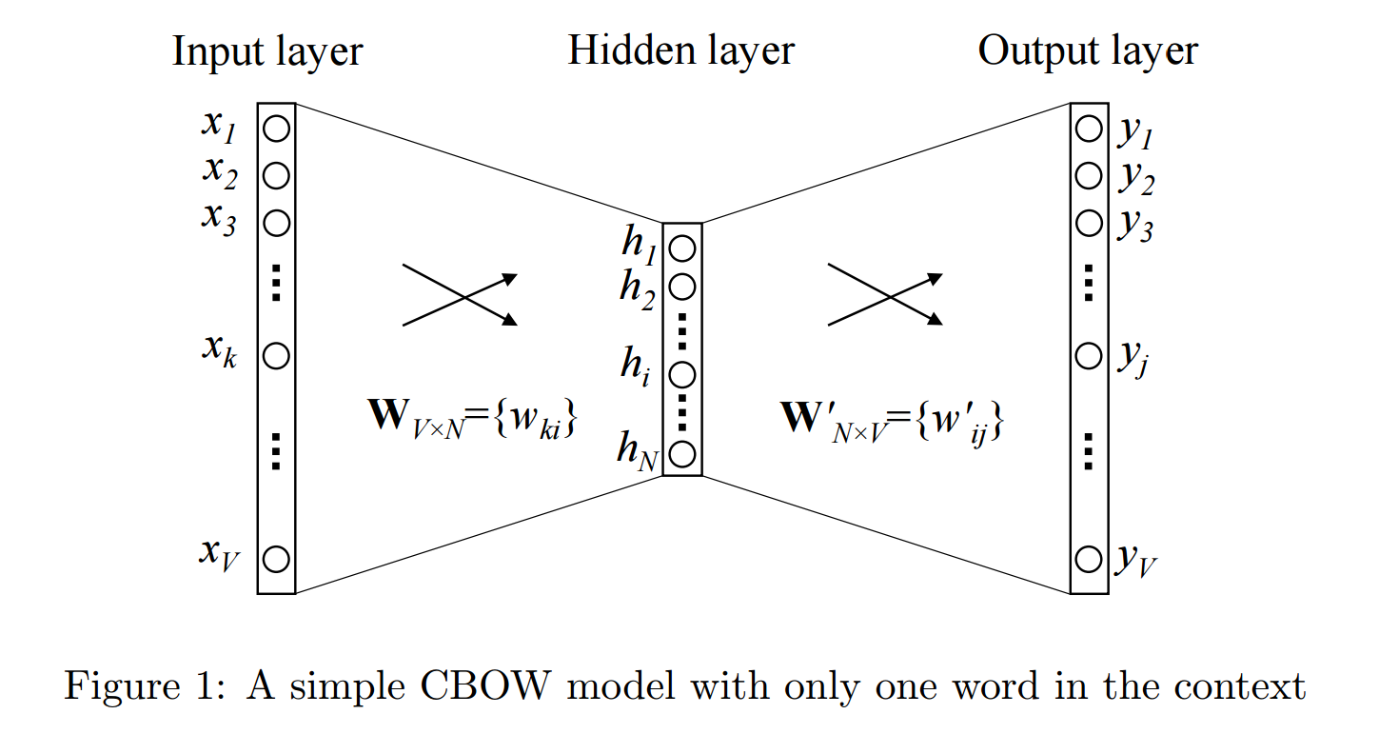
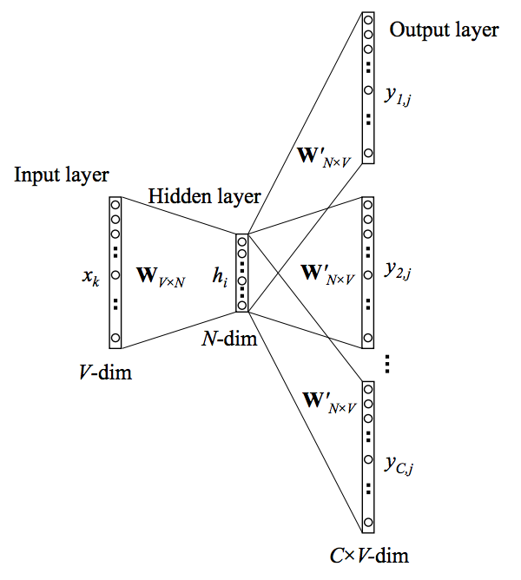
Word2Vec (Mikolov et al 2013)

Slide 17
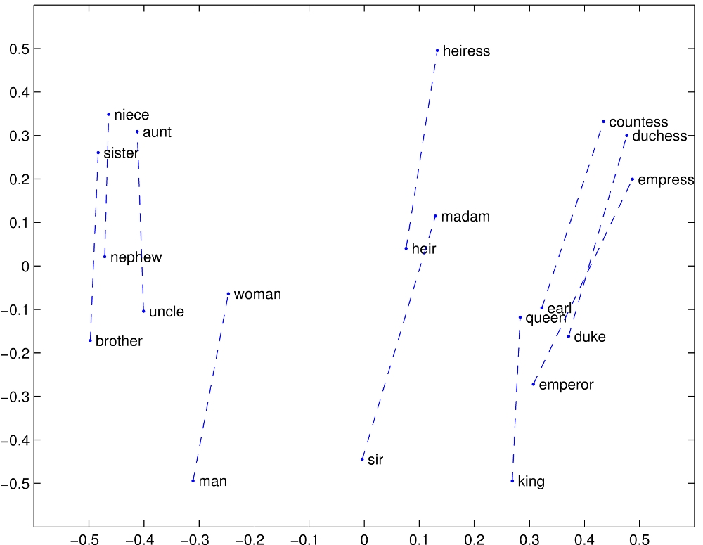
Word embeddings

Slide 18
Word embeddings

Slide 19
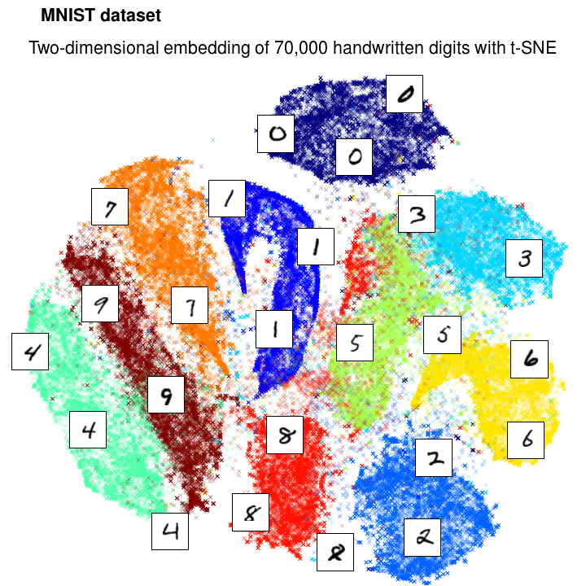
T-SNE visualization technique

Slide 20
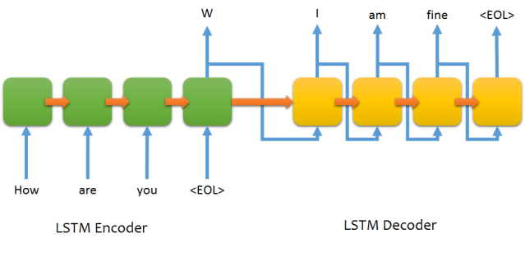
Sequence-to-sequence

